Slide 1
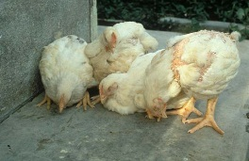
poultry diseases 1
fourth stage
شعار الكلية
chapter one – lecture 3
Ascites
Dr.Harith Abdulla
Department of Pathology and Poultry Disease
College of veterinary medicine university of basrah
University of Basrah- College of veterinary medicine- Department of Pathology and Poultry Disease

Slide 2
Ascites

Slide 3
Definition:
Ascites is a disease of broiler chickens occurs especially at high altitude characterized by an
accumulation of transudate in the peritoneal
cavity or pericardial sac. The fluid, may contain yellow protein clots.

Slide 4
Synonyms:
B.P.H.S. [Broiler Pulmonary Hypertension Syndrome] .
High Altitude Disease.
Edema Disease.
Heart Failure Syndrome.
Dropsy .

Slide 5
Predisposing factors includes:
1-Reduced ventilation.
2- High altitude.
3- Respiratory disease.
Morbidity: Is usually 1-5% .
Mortality: 1-2% but can be 30% at high altitude.

Slide 6
Clinical signs:
1-Sudden death in rapidly developing birds.
2-Poor development.
3-Progressive weakness and abdominal distension.
4-Recumbency.
5-Dyspnea.
6-Possibly cyanosis.

Slide 7
Post-mortem lesions:
Thickening of right-side myocardium.
Dilation of the ventricle.
Thickening of atrioventricular valve.
Generalized congestion.
Liver enlargement.
Spleen is small.
Pericardial effusion.

Slide 10
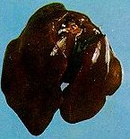
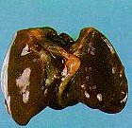
Normal liver liver with Ascites

Slide 11
Microscopic changes: Cartilage nodules are increased in lung. Diagnosis
1-Signs.
2-Lesions: Gross pathology is characteristic.
3-Cardiac specific protein (Troponin T)
may be measured in the blood.

Slide 12
Differential diagnosis:
1-Broiler Sudden Death Syndrome .
2-Bacterial endocarditis.
Treatment:
1-Improve ventilation.
2-Vitamin C .

Slide 13
:Prevention
1-Good ventilation (during incubation
and chick transport).
2- Avoid any genetic tendency.
3- Control respiratory diseases.

